Slide 1
English 2 July 13
Max Keenan

Slide 2
Attendance
What is the scariest thing that has ever happened to you?

Slide 3
Vocabulary Worksheet

Slide 4
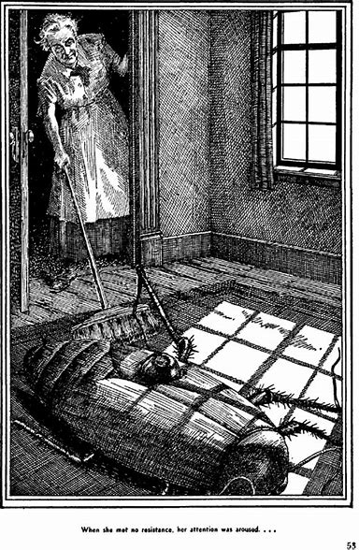
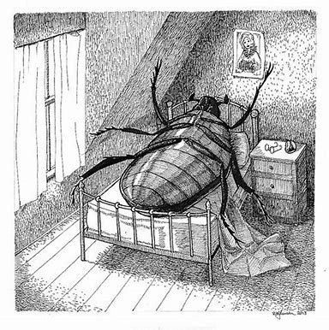
The Metamorphosis

Slide 5
Reading Quiz!

